Slide 1
Titanic Survival Prediction Using Machine Learning
A Comprehensive End-to-End Classification
Project
~ Mayukh Chakraborty

Slide 2
Project Overview :
The Titanic dataset contains passenger data from the tragic Titanic disaster in 1912.
The objective is to predict whether a passenger survived or not based on features
like age, gender, class, and more.
Goal: Develop a machine learning model to accurately predict passenger survival.

Slide 3
Titanic Dataset Overview
Total Rows: 891
Key Features:
Survived: Binary target variable (0 = No, 1 = Yes)
Age: Continuous feature
Fare: Continuous feature
Pclass: Categorical (Passenger Class)
Sex: Categorical (Male/Female)
SibSp & Parch: Family size
Embarked: Port of Embarkation (C = Cherbourg, Q = Queenstown, S = Southampton)
Missing Values: Age, Cabin, Embarked columns have missing data.

Slide 4
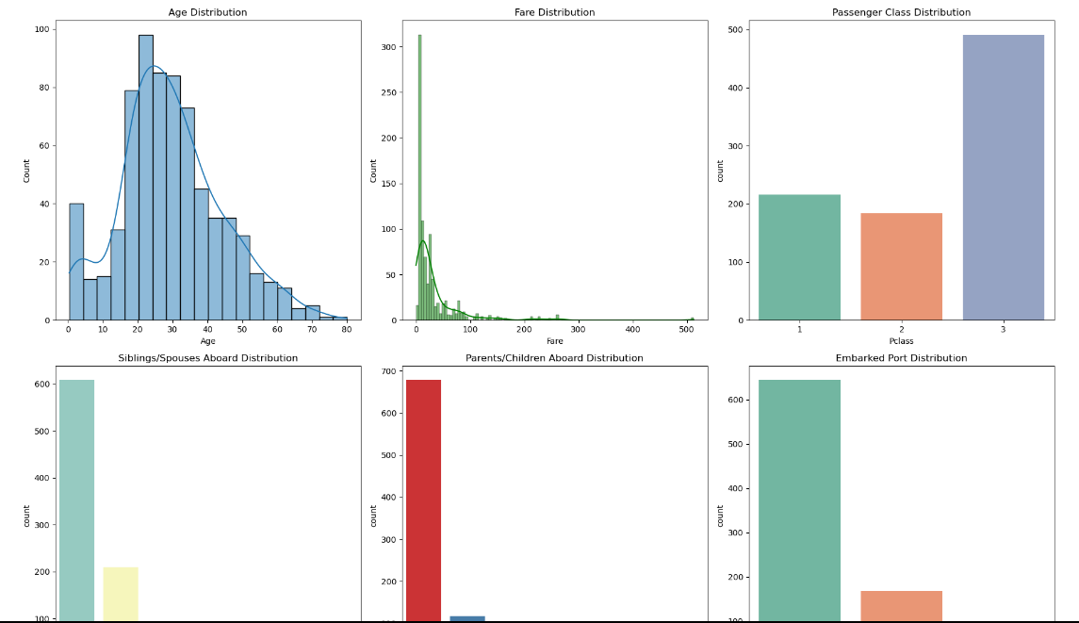
Data Distribution Insights
Distribution of Age and Fare: Histograms showed a skew in both Age and Fare.
Pclass and Survival: Higher survival rates for 1st class passengers.
Gender and Survival: Female passengers had a much higher survival rate than males

Slide 5
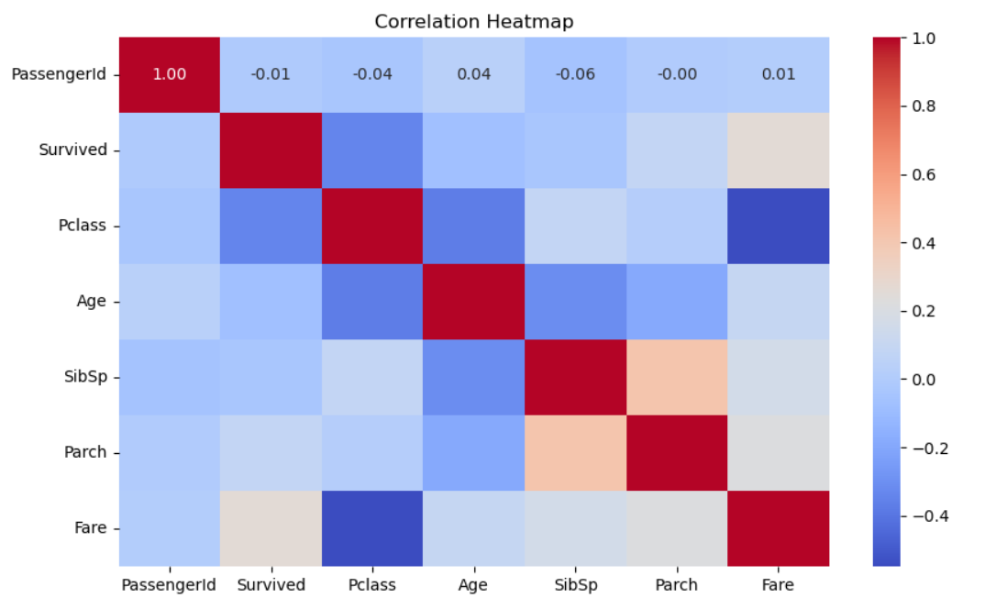
Correlation Analysis and Family Size
Correlation Heatmap: Showed weak correlations between numerical features, but higher class
correlated with survival.
Family Size: Passengers with a moderate family size (2–3) had higher survival rates.

Slide 6
Data Preprocessing
Missing Data Handling:
Age: Imputed using median age for each passenger class.
Embarked: Missing values filled with the most frequent value..
Feature Engineering:
Created FamilySize by combining SibSp and Parch.
Dropped irrelevant features: Cabin, Ticket, etc.
Scaling: Applied standardization to Age and Fare to bring them to a common scale.

Slide 7
Model Selection and Hyperparameter Tuning
Models Tested:
Logistic Regression
Random Forest
Support Vector Machines (SVM)
K-Nearest Neighbors (KNN)
XGBoost
Hyperparameter Tuning: Applied grid search for hyperparameter optimization using cross-validation.
Cross-Validation: Performed 5-fold cross-validation to prevent overfitting and evaluate model performance.

Slide 8
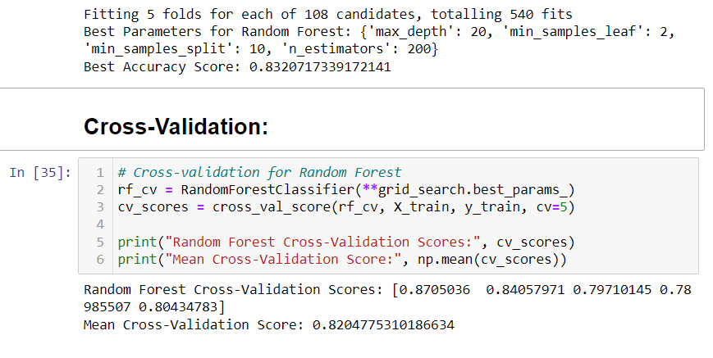
Model Evaluation and Metrics
Evaluation Metrics:
Accuracy
Precision
Recall
F1-score
Best Performing Model:
Random Forest with an accuracy of 83%.
High recall for predicting survivors accurately.

Slide 9
Summary and Next Steps :
Summary:
Explored the Titanic dataset and conducted in-depth data analysis.
Developed multiple classification models, with Random Forest performing the best.
Significant features: Gender, Class, and Fare.
Future Work:
Improve feature engineering (e.g., working on more complex family groupings).
Implement more advanced models like neural networks.
Further optimize hyperparameters for better accuracy.

Slide 10
THANK YOU

